Slide 1
Waveform-Based Feature Analysis in Financial and Economic Times
By Dharun Ramesh, Shiying Li, Mayur Vanne, Richard Wei, Zhenpeng Lin, Shreyon Roy

Slide 2
Introduction
Objective
Understand patterns and drivers in financial time series (e.g., stock prices) using waveform analysis.
Leverage conic sections and Fourier transforms to extract insights.
Key Concepts
Dispersion: White light = target, component colors = feature waveforms; target is a superposition of feature ‘frequencies’.
Conic Sections (Ellipse, Parabola, Hyperbola): Used to model relationships between features and the target.
Waveforms: Transform feature-target relationships into curves that capture trends and anomalies.

Slide 3
Waveform Equations
1. Ellipse Wave (captures moderate correlation) y = mu_y + sy * sqrt(1 - ((x - mu_x)^2 / sx^2))
2. Parabola Wave (captures weak correlation) y = mu_y + (sy^2 / sx^2) * (x - mu_x)^2
3. Hyperbola Wave (captures intermediate correlation) y = mu_y + sy * sqrt(((x - mu_x)^2 / sx^2) - 1), only
for |x - mu_x| >= sx
Where:
mu_x, mu_y → mean of feature x and target y
sx, sy → standard deviation of feature x and target y
Code Reference: ellipse_wave(), parabola_wave(), hyperbola_wave(), choose_waveform_name_and_signal()

Slide 4
Why Use Each Waveform
Waveform | When to Use | Reason
Ellipse | r > 0.1 | Strong correlation, captures cyclical patterns
Parabola | r < 0.1 | Weak correlation, captures trends without saturation
Hyperbola | otherwise | Intermediate correlation, captures asymmetric growth/decay
Dynamic selection based on correlation ensures waveform adapts to data.
Provides a structured, interpretable feature for machine learning models.

Slide 5
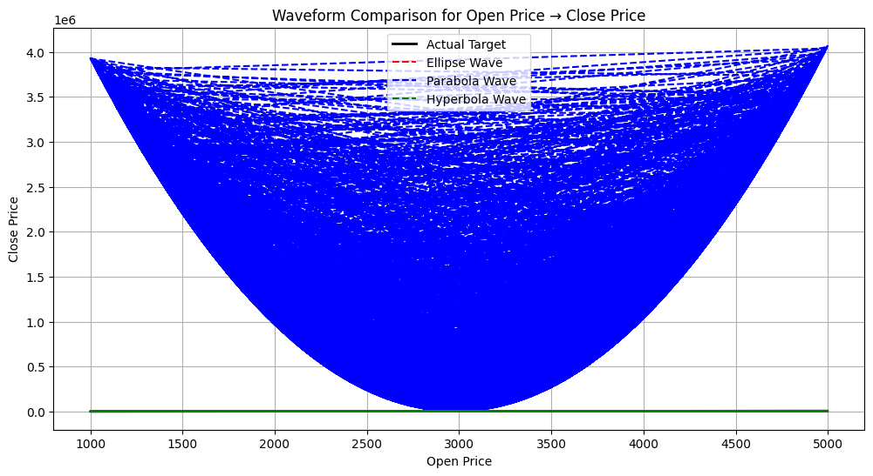
How the transformation to a waveform looks like (Before)

Slide 6
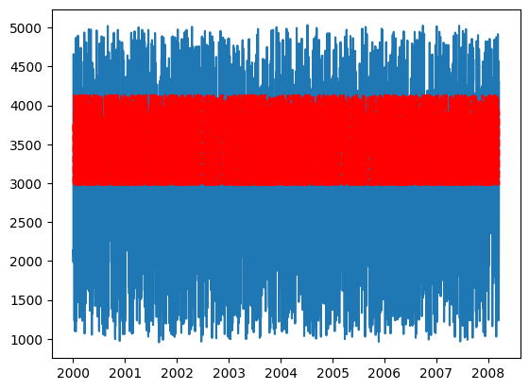
How the transformation to a waveform looks like (After)

Slide 7
Fourier Transform for Feature Insights
What it does: Turns a time-based signal (waveform) into a set of frequencies. Think of it like separating a chord into individual musical notes.
Purpose: Helps us see the main trends, short-term fluctuations (noise), and unusual patterns in the data.
Key Spectral Features:
Dominant Frequency (dom_freq): The strongest repeating pattern in the data – like the main beat in music.
Average Frequency (avg_freq): The overall “center” of the frequencies, giving a sense of the general pace of fluctuations.
Harmonic Count (harmonic_count): How many strong repeating patterns exist – can indicate multiple factors influencing the target together.
High-frequency Fraction (high_energy_fraction): The proportion of rapid fluctuations (noise) versus slower, meaningful trends.
Drift Score (drift_score): Measures slow shifts in the data – can indicate regime changes or changing market conditions.

Slide 8
Interpreting the FFT Results
Feature | Interpretation
High-frequency (dom>0.15) | Short-term noise or fluctuations
Low-frequency (dom<0.02) | Fundamental driver / slow trend
Drift score high | Possible regime change
Harmonic count ≥ 3 | Multi-variable correlation / coupling
Wavelength contraction (dom > 1.5*avg) | Market compression / volatility bottleneck
Wavelength expansion (dom < 0.75*avg) | Instability buildup / bubble formation
No strong signal | Mixed-frequency, weak or noisy signal
FFT = fft(signal - mean(signal)) - Converts to frequency domain
Magnitude = abs(FFT) - Strength of each frequency
Dominant frequency = frequency of largest magnitude
Average frequency = sum(frequency * magnitude) / sum(magnitude)
High-frequency fraction: How “jumpy” the signal is compared to its overall movement.
Drift score: How much the signal’s average slowly shifts over time.

Slide 9
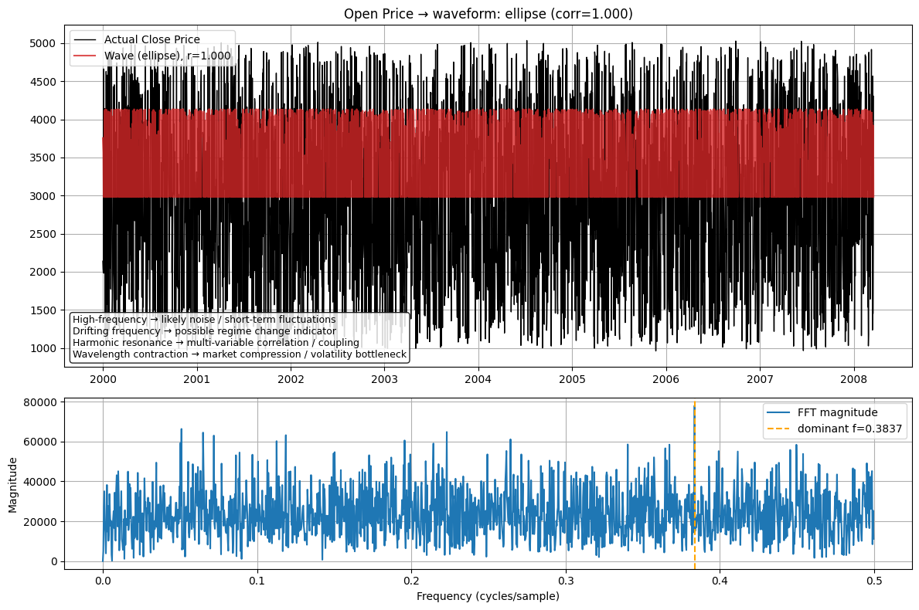
Analysis for Open Price

Slide 10
Open Price - Observations
Strong ellipse-shaped waveform pattern implies highly consistent fluctuation band.
Dominant frequency around 0.38 cycles/sample implies fast, repetitive movements.
High high-frequency fraction implies strong short-term noise.
Possible harmonic resonance implies multiple market influences interacting.
Wavelength contraction hints at volatility bottlenecks / compression phases.

Slide 11
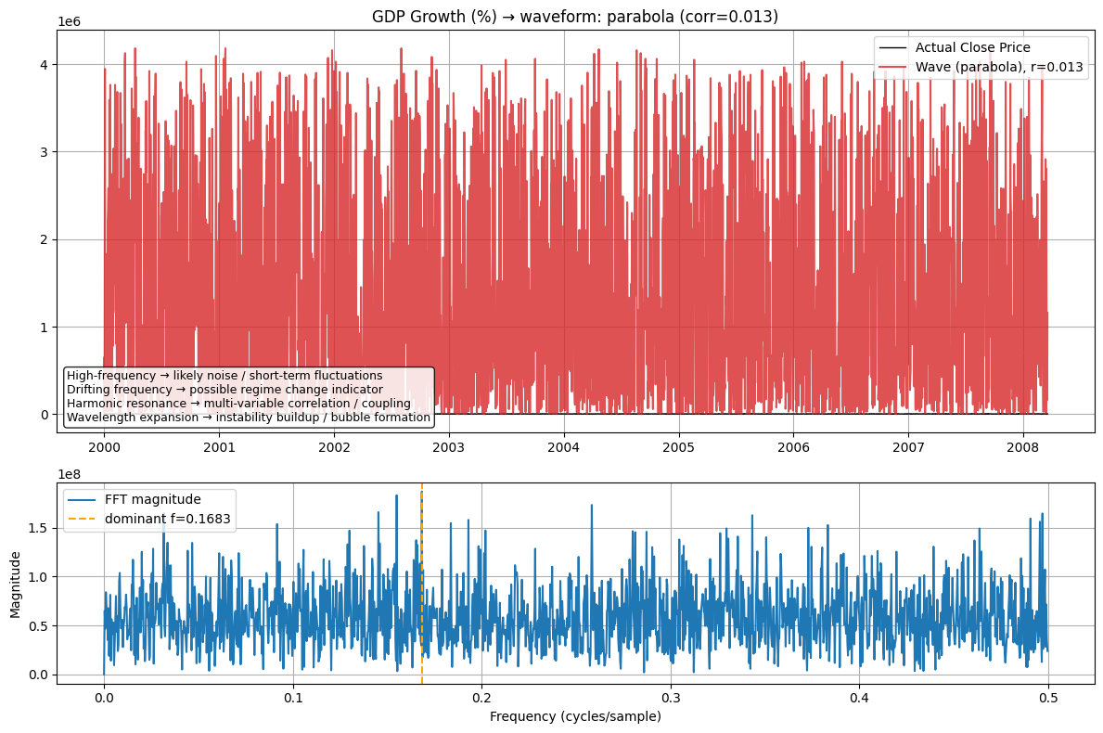
Analysis of GDP contribution

Slide 12
GDP Growth – Observations
Parabolic waveform shape that implies weaker correlation with price, more macro-driven.
Lower dominant frequency (~0.17) implies slower, fundamental cycles.
High-frequency energy still present but less structurally meaningful.
Wavelength expansion suggests periods of instability buildup or pre-bubble phases.
Harmonic count is lower which implies fewer interacting cyclical forces than in price data.

Slide 13
What can we infer from GDP Growth and Open Price
Market prices fluctuate much faster than macroeconomic variables.
Higher noise levels in open price reflect short-term sentiment and volatility.
GDP cycles are slower but may influence longer-term drift.
Spectral drift differences may signal times when macro trends lead market regime changes.

Slide 14
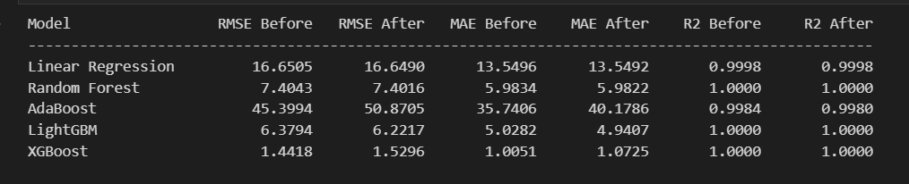
Model Performance

Slide 15
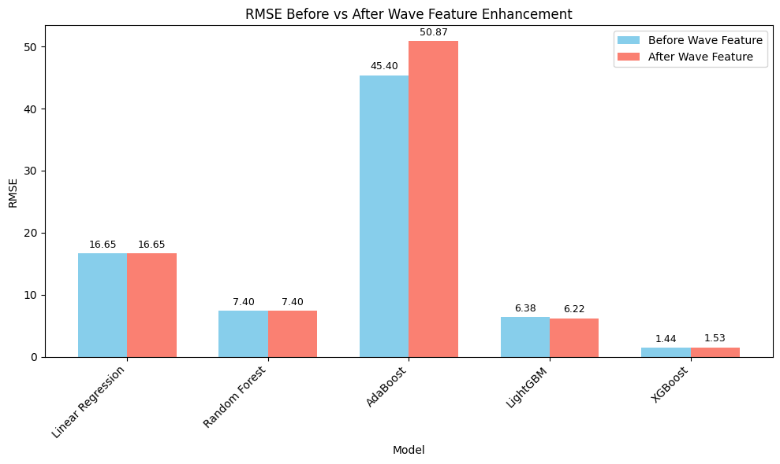

Slide 16
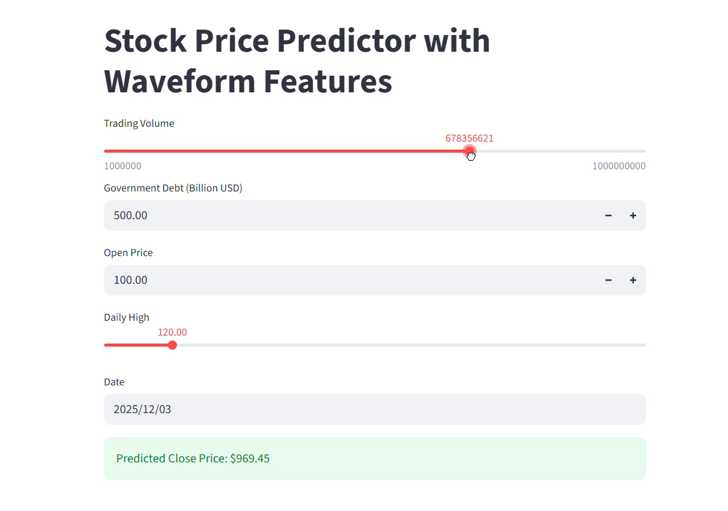
Final Dashboard

Slide 17
References
Feature analysis and how the transforms work: https://colab.research.google.com/drive/1jntJlKl_TJDgBdANKHXgUPAKVseiBt7n?usp=sharing
How the models perform:
https://colab.research.google.com/drive/1CTfANWMrYHyMmZynhg5hyCwRVM5thxtp?usp=sharing
Mathematical Derivations:
https://drive.google.com/file/d/121VNwr-D3skS2EEr5oLH8hN_TVPhEg9B/view?usp=sharing

Slide 18
Key Takeaways
Waveform analysis captures nonlinear and cyclical dependencies between features and target.
Fourier Transform identifies underlying frequency patterns, helping distinguish noise from meaningful signals.
Integration with ML models improves prediction accuracy by enhancing feature representation.
Waveforms provide interpretability: know why a feature drives prediction.

Slide 19
Thank You

